Slide 1
Chapter 14
Inheritance and Polymorphism

Slide 2
List of contents
Constructors in Inheritance
Overriding Super class constructors and methods
The super() method
Types of Inheritance
Method Resolution Order (MRO)
Polymorphism
Duck Typing Philosophy of Python
Operator Overloading
Method Overloading
Method Overriding

Slide 3
Introduction to inheritance
Software development is a team effort. Several programmers will work as a team to develop software. When a programmer develops a class, he will use its features by creating an instance to it. When another programmer wants to create another class which is similar to the class already created, then he need not create the class from the scratch. He can simply use the features of the existing class in creating his own class.
Let's take an example to understand this.
Program 1: A Python program to create Teacher class and store it into teacher.py module
Program 2: A Python program to use the Teacher class (File name: inh.py)
Go to IDLE for example

Slide 4
So, the program is working well. There is no problem. Once the Teacher class is completed, the programmer stored teacher.py program in a central database that is available to all the members of the team. So, Teacher class is made available through the module teacher.py as shown in following Figure.
teacher.py
Programmer 1
Programmer 2
Fig: The teacher.py module is created and available in the project database

Slide 5
Now another programmer in the same team wants to create a Student class.
He is planning the Student class without considering the Teacher class as shown in Program 3.
Program 3: A Python program to create Student class and store it into student.py module.
Now, the second programmer who created this Student class and saved it as student.py can use it whenever he needs. Using the Student class is shown in Program 4.
Program 4: A Python program to use the Student class which is already available in student.py (File name: inh1.py)
Go to IDLE for example

Slide 6
So far, so nice! If we compare the Teacher class and the Student classes, we can understand that 75% of the code is same in both the classes. That means most of the code being planned by the second programmer in his Student class is already available in the Teacher class. Then why doesn't he use it for his advantage?
Our idea is this: instead of creating a new class altogether, he can reuse the code which is already available. This is shown in Program 5.
Program 5: A Python program to create Student class by deriving it from the Teacher class (file name: student_v2.py)
In program 6, Create the instance to the Student class and calling the methods in student_v2.py module (file name: inh2.py)
Go to IDLE for example
Here in program 5, we can say that we have created Student class from the Teacher class. This is called inheritance.

Slide 7
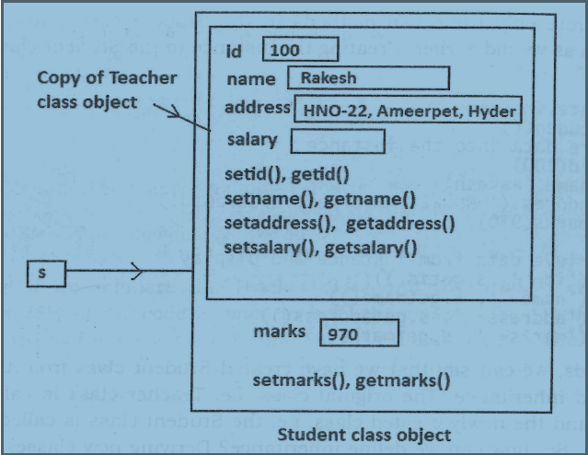

Slide 8
Constructors in Inheritance
In the previous programs, we have inherited the Student class from the Teacher class. All the methods and the variables in those methods of the Teacher class (base class) are accessible to the Student class (sub class).
Are the constructors of the base class accessible to the sub class or not? — is the next question we will answer. In the next Program, we are taking a super class by the name 'Father' and derived a sub class 'Son' from it. The Father class has a constructor where a variable 'property' is declared and initialized with 800000.00. When Son is created from Father, this constructor is by default available to Son class. When we call the method of the super class using sub class object, it will display the value of the 'property' variable.
Go to Jupyter notebook for example
The conclusion is this: like the variables and methods, the constructors in the super class are also available to the sub class object by default

Slide 9
Overriding Super class constructors and methods
When the programmer writes a constructor in the sub class, the super class constructor is not available to the sub class.
In this case, only the sub class constructor is accessible from the sub class object. That means the sub class constructor is replacing the super class constructor. This is called constructor overriding.
Similarly in the sub class, if we write a method with exactly same name as that of super class method, it will override the super class method. This is called method overriding.
Go to Jupyter notebook for example
In this case, how to call the super class constructor so that we can access the father's property from the Son class?
For this purpose, we should call the constructor of the super class from the constructor of the sub class using the super() method.

Slide 10
The super() method
super() is a built-in method which is useful to call the super class constructor or methods from the sub class.
Any constructor written in the super class is not available to the sub class if the sub class has a constructor. Then how can we initialize the super class instance variables and use them in the sub class?
This is done by calling the super class constructor using the super() method from inside the sub class constructor.
Go to Jupyter notebook for examples

Slide 11
Types of Inheritance
All classes in Python are built from a single super class called 'object'. If a programmer creates his own classes, by default object class will become super class for them internally.
This is the reason, sometimes while creating any new class, we mention the object class name in parentheses as:
class Myclass(object):
Of course, writing object class name is not mandatory and hence the preceding code is equivalent to writing:
class Myclass:
Now, coming to the types of inheritance, there are mainly 2 types of inheritance available. They are:
Single inheritance
Multiple inheritance

Slide 12
Single Inheritance
Deriving one or more sub classes from a single base class is called 'single inheritance'. In single inheritance, we always have only one base class, but there can be n number of sub classes derived from it.
Go to Jupyter notebook for example
Multiple Inheritance
Deriving sub classes from multiple (or more than one) base classes is called 'multiple inheritance'. In this type of inheritance, there will be more than one super class and there may be one or more sub classes. All the members of the super classes are by default available to sub classes and the sub classes in turn can have their own members.
Go to Jupyter notebook for example

Slide 13
Problems in Multiple Inheritance
If the sub class has a constructor, it overrides the super class constructor and hence the super class constructor is not available to the sub class. But writing constructor is very common to initialize the instance variables.
The same thing is applicable to methods as well
To understand the problem of multiple inheritance, please Go to Jupyter notebook

Slide 14
Method Resolution Order (MRO)
In the multiple inheritance scenario, any specified attribute or method is searched first in the current class. If not found, the search continues into parent classes in depth-first, left to right fashion without searching the same class twice. Searching in this way is called Method Resolution Order (MRO). There are three principles followed by MRO.
The first principle is to search for the sub class before going for its base classes. Thus if class B is inherited from A, it will search B first and then goes to A.
The second principle is that when a class is inherited from several classes, it searches in the order from left to right in the base classes. For example, if class C is inherited from A and B as class C(A,B), then first it will search in A and then in B.
The third principle is that it will not visit any class more than once. That means a class in the inheritance hierarchy is traversed only once exactly.
Understanding MRO gives us clear idea regarding which classes are executed and in which sequence. We can easily estimate the output when several base classes are involved. To know the MRO, we can use mro() method as:
classname.mro()
This returns the sequence of execution of the classes, starting from the class with which the method is called. As depicted in following Figure, we are going to create inheritance hierarchy with several classes. The sub class for all these classes is P

Slide 15
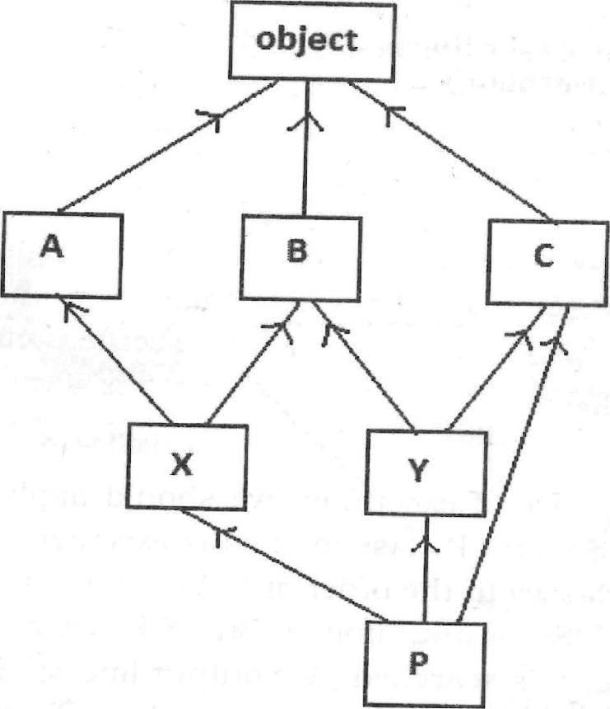
Fig: Inheritance hierarchy with several classes
Go to Jupyter notebook for example

Slide 16
Polymorphism
Polymorphism is a word that came from two Greek words, poly means many and morphos means forms.
If something exhibits various forms, it is called polymorphism.
Let's take a simple example in our daily life. Assume that we have wheat flour. Using this wheat flour, we can make burgers, rotis, or loaves of bread. It means same wheat flour is taking different edible forms and hence we can say wheat flour is exhibiting polymorphism

Slide 17
In programming, a variable, object or a method will also exhibit the same nature as that of the wheat flour.
A variable may store different types of data, an object may exhibit different behaviors in different contexts or a method may perform various tasks in Python. This type of behavior is called polymorphism.
Python has built-in polymorphism.
The following topics are examples for polymorphism in Python:
Duck typing philosophy of Python
Operator overloading
Method overloading
Method overriding

Slide 18
Duck Typing Philosophy of Python
We know that in Python, the data type of the variables is not explicitly declared. This does not mean that Python variables do not have a type. Every variable or object in Python has a type and the type is implicitly assigned depending on the purpose for which the variable is used.
In the following examples, 'x' is a variable. If we store integer into that variable, its type is taken as 'int' and if we store a string into that variable, its type is taken as `str'. To check the type of a variable or object, we can use type() function.
>>> x = 5
>>> print(type(x))
<class 'int'>
>>> x = 'Hello'
>>> print(type(x))
<class 'str'>
Python variables are names or tags that point to memory locations where data is stored. They are not worried about which data we are going to store. So, if 'x' is a variable, We can make it refer to an integer or a string as shown in the previous examples.

Slide 19
We can conclude two points from this discussion:
Python's type system is 'strong' because every variable or object has a type that we can check with the type() function.
Python's type system is 'dynamic' since the type of a variable is not explicitly declared, but it changes with the content being stored.
Similarly, if we want to call a method on an object, we do not need to check the type of the object and we do not need to check whether that method really belongs to that object or not.
For example, take a method call_talk() that accepts an object (or instance)
Go to Jupyter notebook for example
During runtime, if it is found that the method does not belong to that object, there will be an error called 'AttributeError'.
Go to Jupyter notebook for example

Slide 20
In the following example, we are checking whether the object has a method or not with the help of hasattr() function. This function is written in the form of:
hasattr(object, attribute)
Here, 'attribute' may be a method or variable. If it is found in the object (i.e. in the class to which the object belongs) then this method returns True, else False.
Checking the object type (or class) in this manner is called `strong typing'.
Please understand that this is not duck typing.
Go to Jupyter notebook for example

Slide 21
Operator Overloading
We know that an operator is a symbol that performs some action. For example, ‘+’ is an operator that performs addition operation when used on numbers. When an operator can perform different actions, it is said to exhibit polymorphism
Go to Jupyter notebook for example
But, we cannot use the addition operator to add two objects, as: obj l+obj2. Our intention of writing like this is to use the addition operator to add the data of these two objects. This is not possible. For example if we have two classes BookX and BookY. Each book has a number of pages which is given at the time of creating the objects as:
bl = BookX(100) b2 = BookY(150)
Now, if we write b1+b2, the addition operator cannot add the number of pages which are available in the objects since this operator cannot act on the objects.
In order to achieve this we can use special or magic method __add__()
Go to Jupyter notebook for example

Slide 22
Important operators and their corresponding internal methods that can be overridden to act on objects. These methods are called magic or special methods
Operator | Magic or special method
+ | object.__add__(self, other)
- | object.__sub__ (self, other)
* | object. __mul__(self, other)
/ | object.__div__ (self, other)
// | object.__floordiv __(self, other)
% | object.__mod__ (self, other)
** | object.__pow__ (self, other[, modulo])
+= | object. __iadd__(self, other)
-= | object.__isub__(self, other)
*= | object.__imul__ (self, other)
/= | object.__idiv__(self, other)
//= | object.__ifloordiv__(self, other)
%= | object.__imod__ (self, other[, modulo])
*= | object.__ipow __(self, other)
< | object.__lt__(self, other)
<= | object. __le__(self, other)
> | object.__gt__(self, other)
>= | object.__ge__(self, other)
== | object.__eq__ (self, other)
!= | object.__ne__(self,other)

Slide 23
Method Overloading
If a method is written such that it can perform more than one task, it is called met overloading. We see method overloading in the languages like Java. For example, we a method as:
sum(10, 15) {
---------
---------
}
sum(10, 15, 20){
--------
---------
}
Method overloading is not available in Python. Writing more than one method with the same name is not possible in Python.
So, we can achieve method overloading by writing same method with several parameters. The method performs the operation depending on the number of arguments passed in the method call.
Go to Jupyter notebook for example

Slide 24
Method Overriding
When there is a method in the super class, writing the same method in the sub class so that it replaces the super class method is called 'method overriding'.
The programmer overrides the super class methods when he does not want to use them in sub class. Instead, he wants a new functionality to the same method in the sub class
In inheritance, if we create super class object (or instance), we can access all the members of the super class but not the members of the sub class. But if we create sub class object, then both the super class and sub class members are available since the sub class object contains a copy of the super class. Hence, in inheritance we always create sub class object.
Go to Jupyter notebook for example

